Slide 1
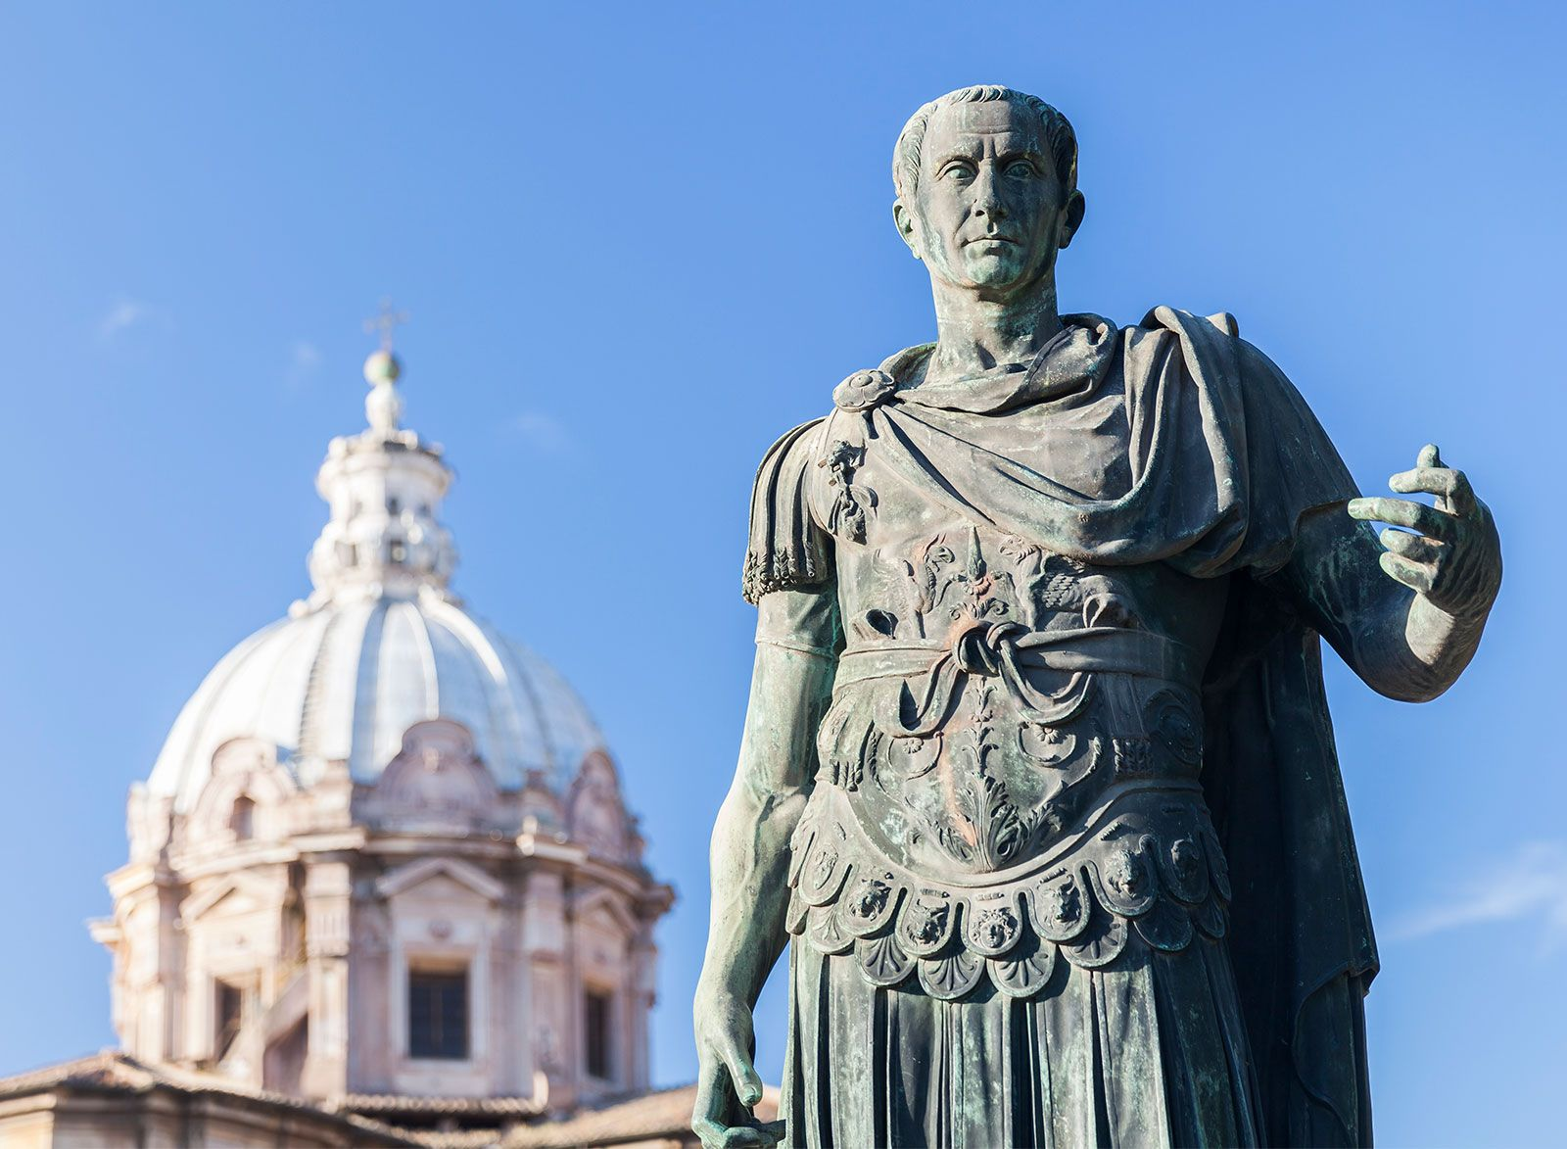
The Gallic Wars
- Identify and explain the events of the Gallic Wars
Week 7 Lesson 2
Ms Barrie

Slide 2
Watch the following video:
https://www.youtube.com/watch?v=8rCBiYEKxko&ab_channel=AncientHistoryGuy

Slide 3
The Gallic Wars were waged between 58 and 50 BCE by the Roman general Julius Caesar against the peoples of Gaul ( present-day France, Belgium, Germany, and Switzerland). Gallic, Germanic, and British tribes fought to defend their homelands against an aggressive Roman campaign. The Wars culminated in the decisive Battle of Alesia in 52 BCE, in which a complete Roman victory resulted in the expansion of the Roman Republic over the whole of Gaul. Though the Gallic military was as strong as the Romans, the Gallic tribes' internal divisions eased victory for Caesar. Gallic chieftain Vercingetorix's attempt to unite the Gauls under a single banner came too late. Caesar portrayed the invasion as being a preemptive and defensive action, but historians agree that he fought the Wars primarily to boost his political career and to pay off his debts. Still, Gaul was of significant military importance to the Romans. Native tribes in the region, both Gallic and Germanic, had attacked Rome several times. Conquering Gaul allowed Rome to secure the natural border of the river Rhine.

Slide 4
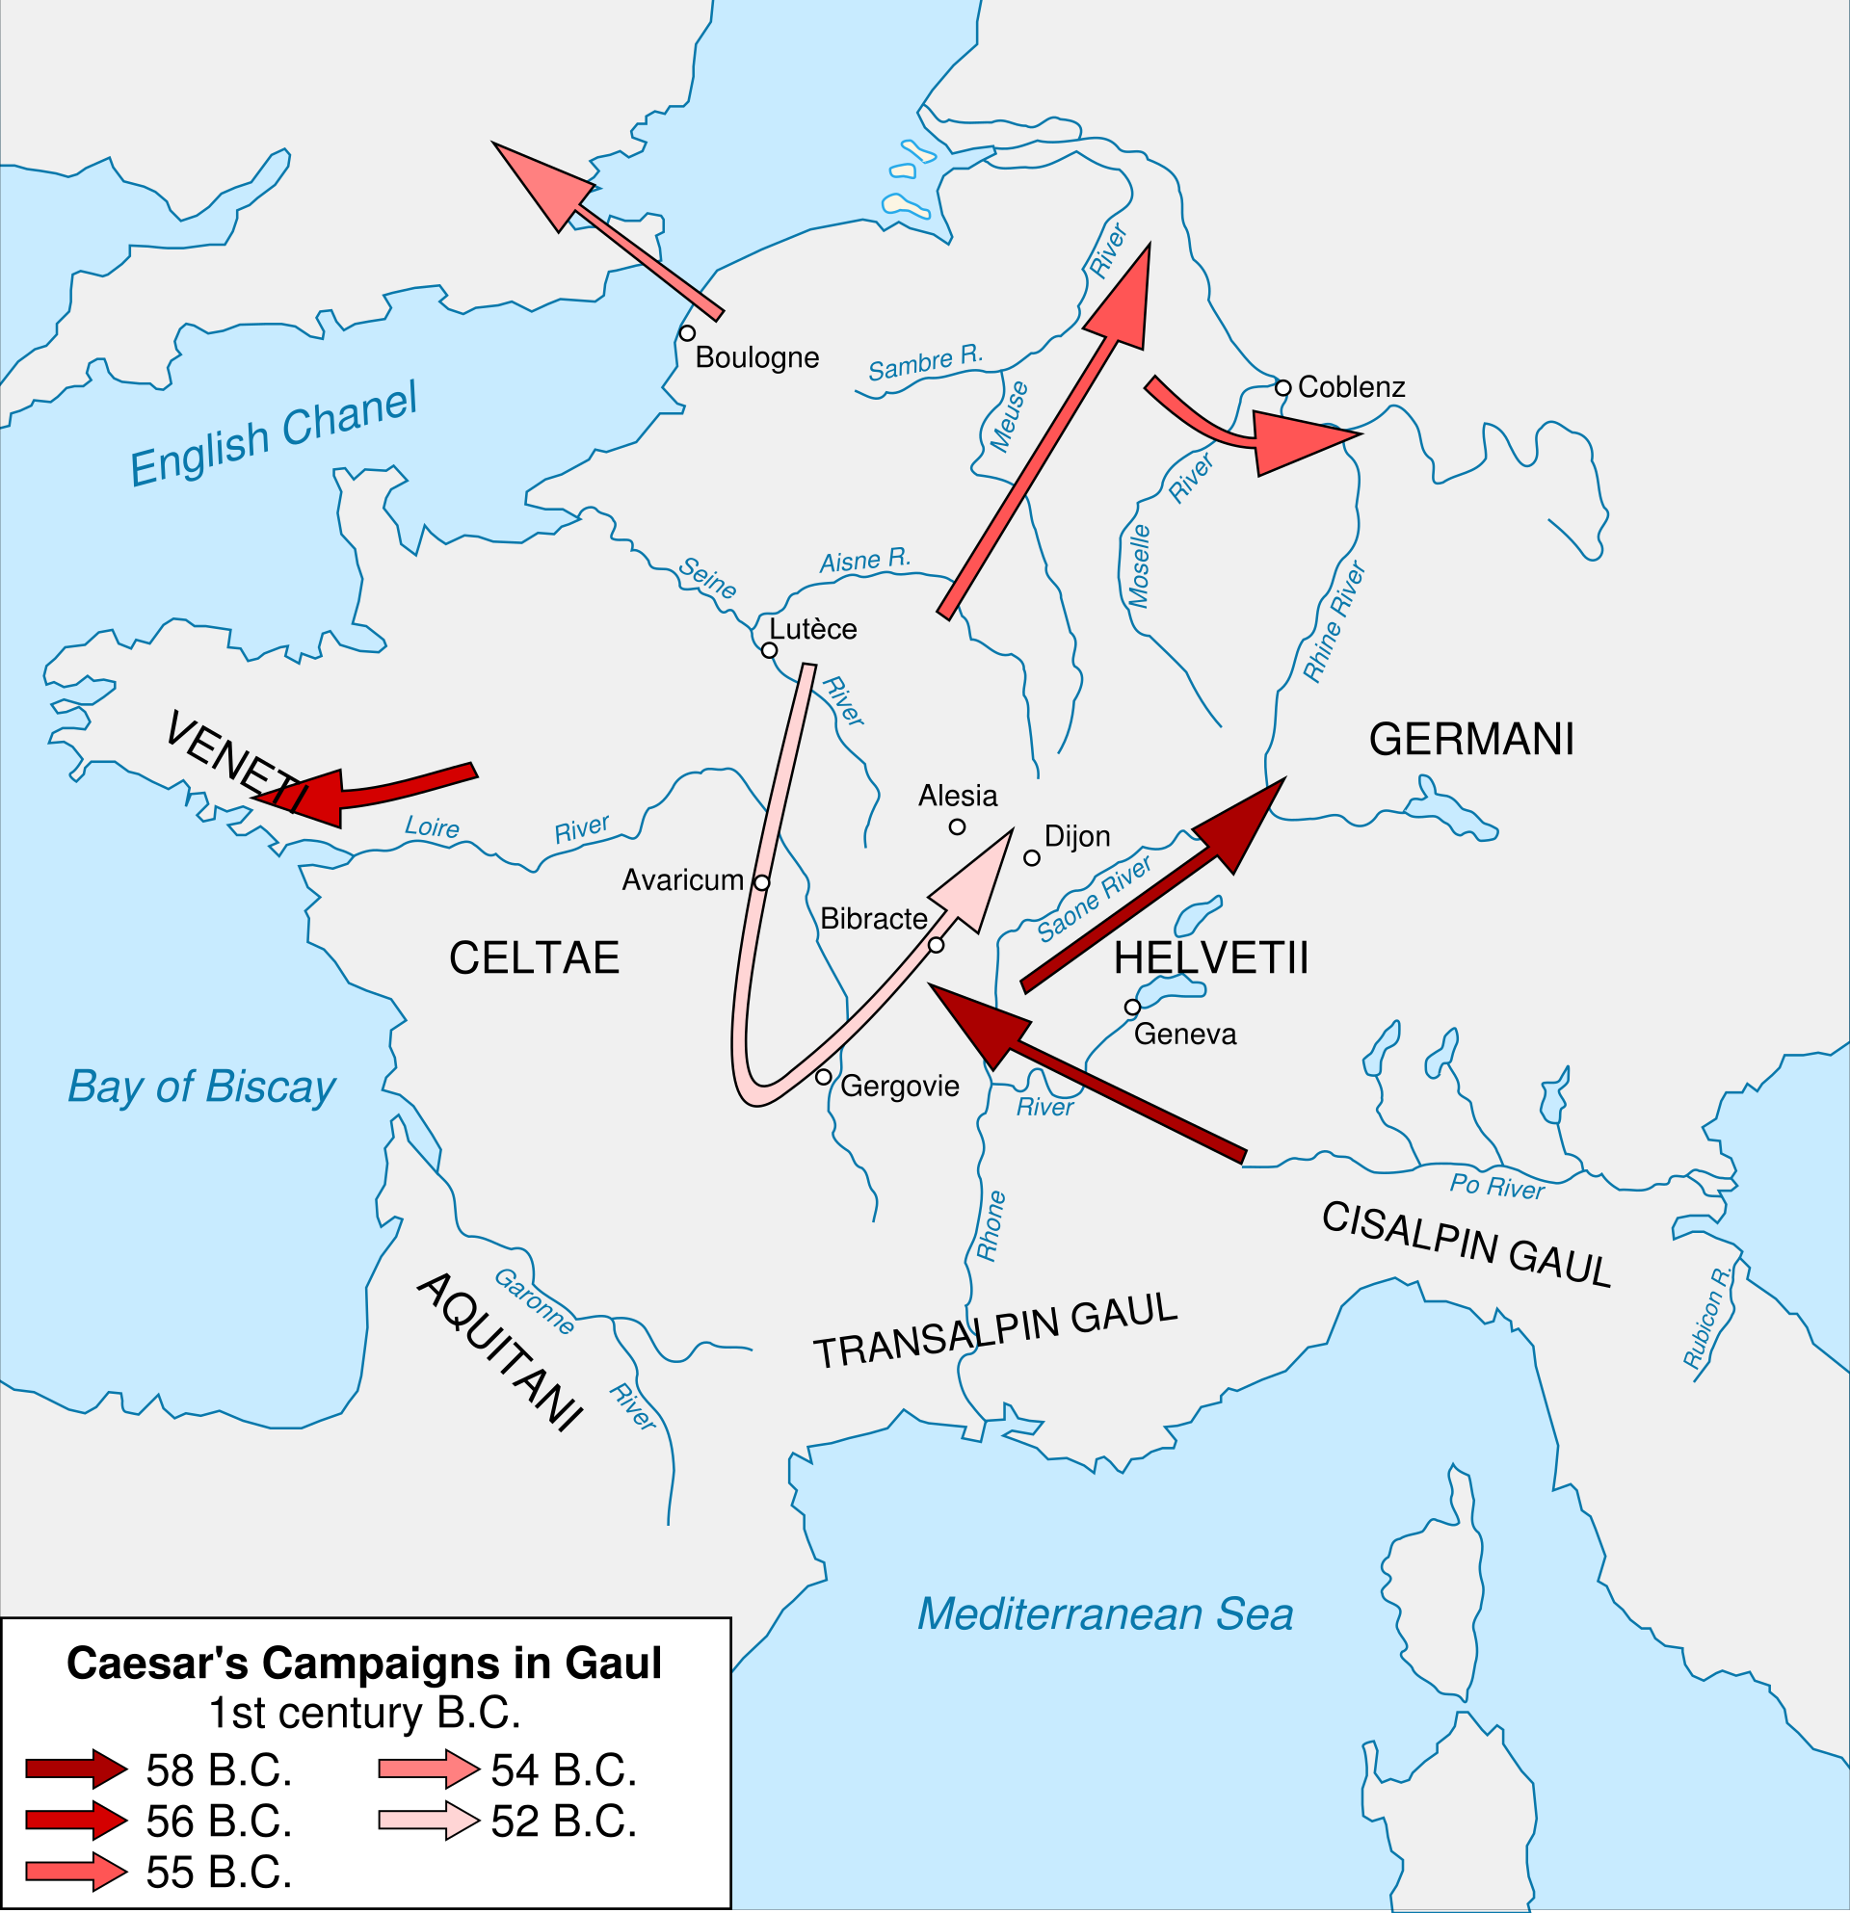
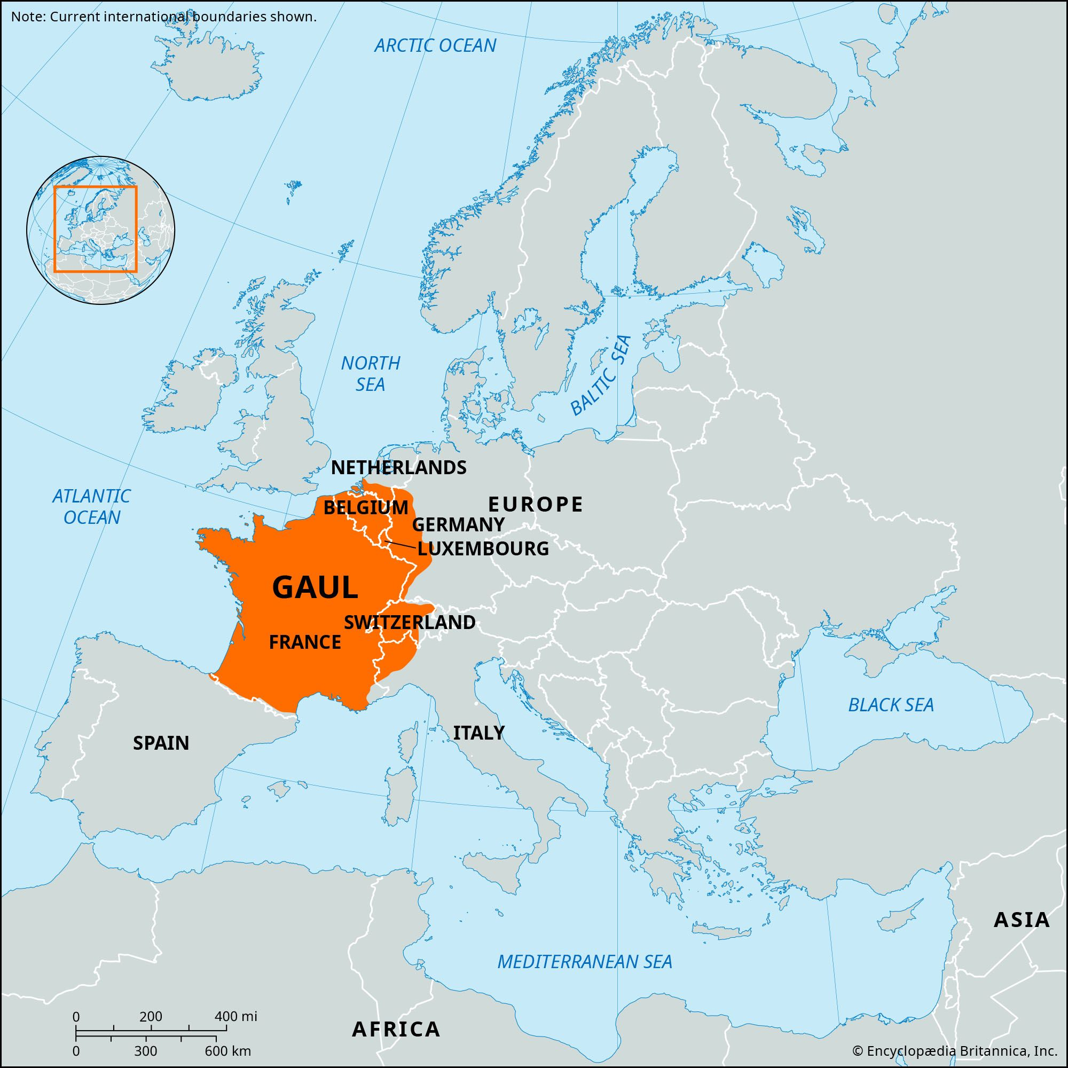

Slide 5
OVERVIEW
The Gallic Wars were a series of military campaigns fought by the Roman republic between 58 BCE and 51 BCE.
The wars were fought in an effort to expand the territory of the republic, as well as to subdue the rebellious Gauls who had been a strategic concern to Rome for centuries.
Caesar was tasked with leading the Roman legions against the Gauls, and he did so with great success.
After eight years of fighting, Caesar emerged victorious and established Rome's dominance over Gaul.

Slide 6
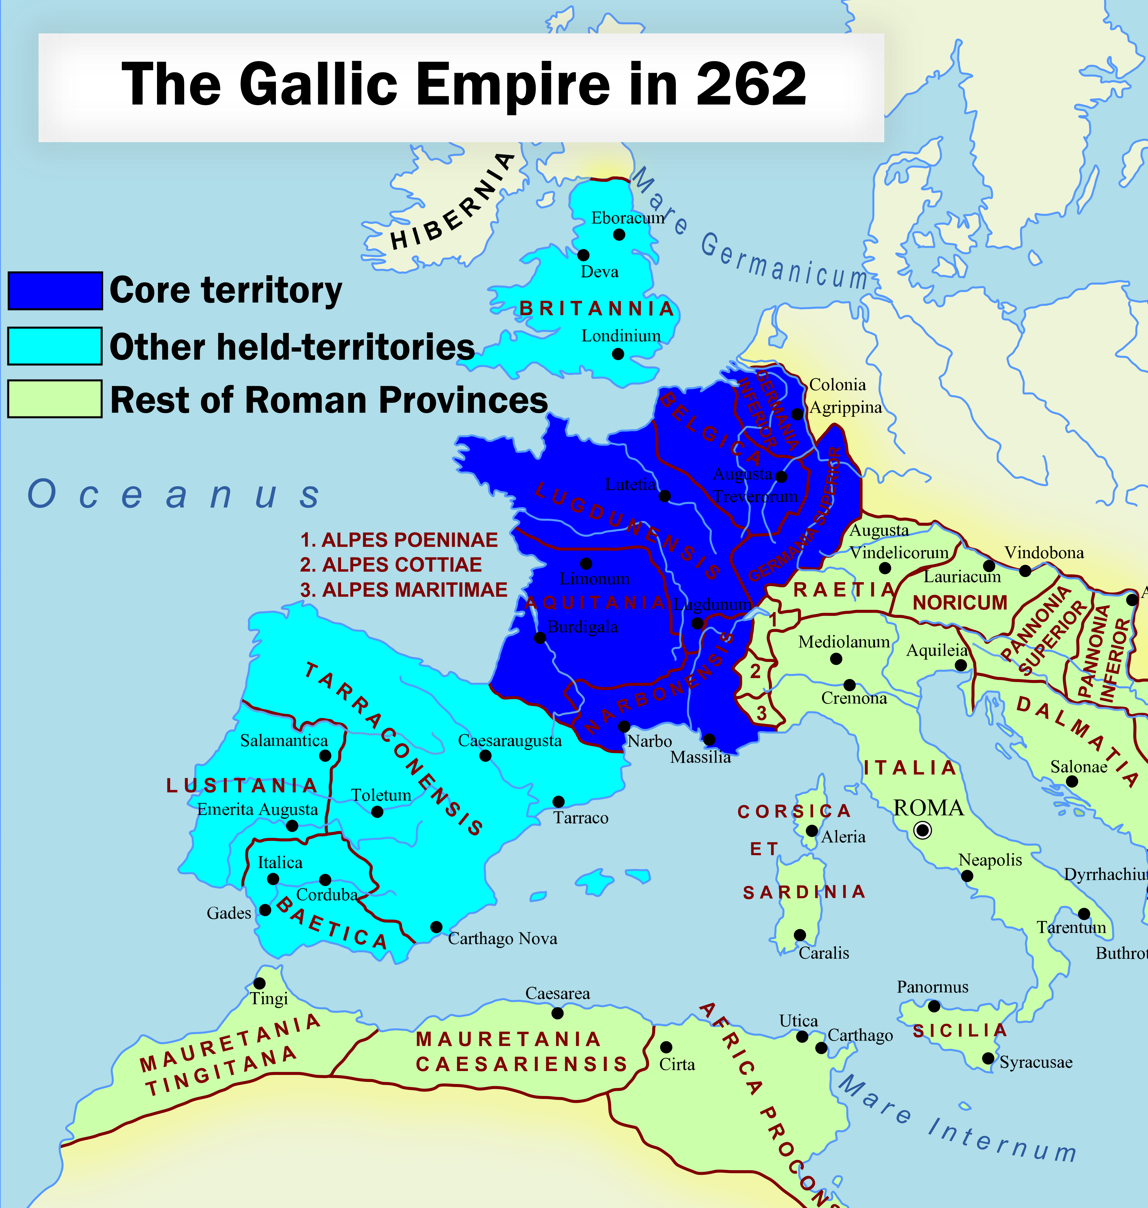
Gallic
Write the definition in your book
DEFINITION:
of or characteristic of France or the French
AND
relating to the Gauls
The relationship between Rome and Gaul can be traced back to the time of the Roman Republic's founding in 509 BC. No Roman army had successfully attempted to subdue the region and some fear still remained about what Gallic armies were capable of.

Slide 7
ACTIVITY - Jigsaw
Each student will receive ONE A3 worksheet with a flow-chart of the events of the Gallic Wars
As you receive an info sheet, read through it.
SUMMARISE the information on your worksheet.
5 MIN PER SHEET ONLY!

Slide 8
The Gallic Wars Come to an end
By 51 BCE, all of Gaul had been conquered by Rome and the Gallic Wars came to an end. This was a major victory for Julius Caesar and the Roman Republic.
The Gallic Wars had lasted for nearly a decade, involved around 300 separate battles, with the capture of over 800 settlements by Rome.
The Gauls themselves paid the highest price of the conquest. The various Gallic tribes had now suffered numerous conquests, defeats and slaughters at the hands of Caesar's troops.
Of an estimated 6,000,000 people that had been living in Gaul before Caesar arrived in 58 BCE, around 1,000,000 had been killed, and another 1,000,000 had been sold into slavery by 50 BCE.
However, the war was a turning point in Roman history. It established Rome as a major power in the world and paved the way for the Roman Empire.
The Gallic Wars also cemented Julius Caesar's reputation as one of the greatest military commanders in history.
In the long-term, the Gallic Wars also had a profound impact on Rome and its empire.
First, the wars increased Rome's territory significantly. Second, the defeat of the Gauls established Rome's dominance over them once and for all.
Finally, the war made Julius Caesar one of the most famous men in Roman history and laid the foundation for his future political career.
SUMMARY:
Identify (list) the impacts of the Gallic Wars

